Slide 1
Moving Violations in D.C.
An analysis of all 266,000 moving vehicle violations from October 2024
Isaac Nashagh

Slide 2
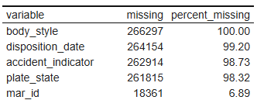

Data
Summary
266,297 rows and 29 columns
Variables included things like violation type, location, issue date/time, fine amount, and issuing agency.
Minor cleaning was needed for the data like converting the format for time values
Values like body type, disposition date and total paid were the only incomplete variables

Slide 3
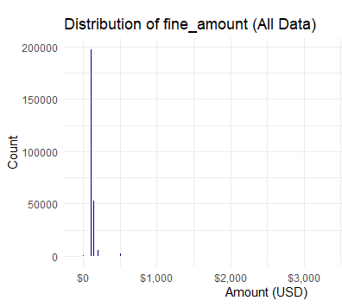
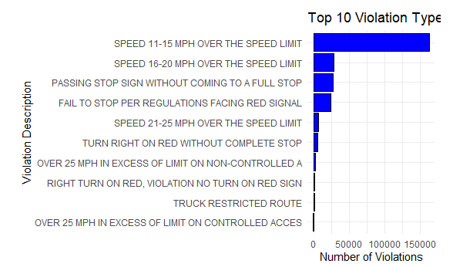
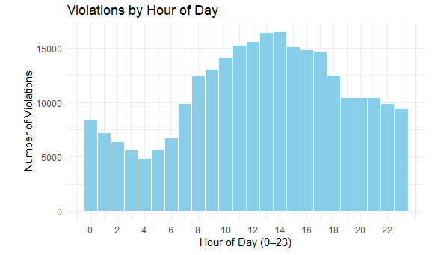
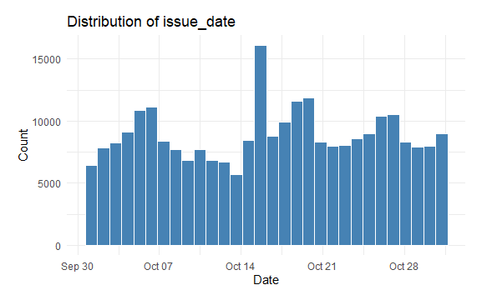
Interesting Stats!
Summary

Slide 4
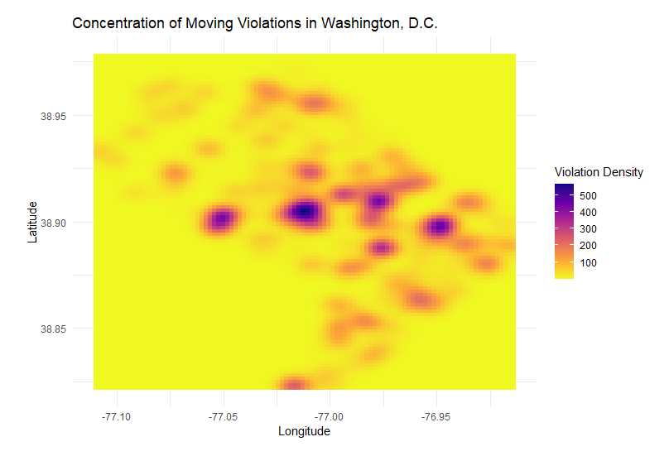
Analysis
Summary
Driving Question:
Do areas near government buildings like courthouses and police stations experience higher policing and ticketing rates?
Conclusion:
Yes! - Judiciary square/Downtown D.C. is the largest cluster on the heatmap.
Other high traffic areas include Union Station (NE), the area immediately around the MPD station (W), and the RFK Stadium/ National Guard Armory (E).

Slide 5
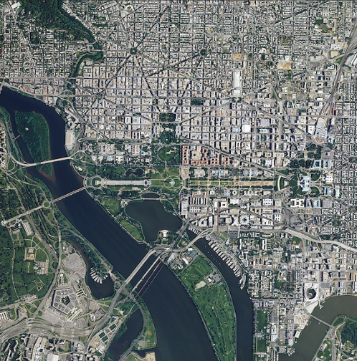
Results
My analysis of this dataset allowed me to answer all questions I had when I first started. It clearly showed that almost all violations were for speeding 11-20 MPH over the limit. Violations followed a daily pattern, peaking at 1-2pm and hitting a low at 5am, likely due to traffic and police activity at those hours. Violations were also largely centered on community hubs and government buildings.
If I were to continue this study I would like to examine violation type and quantity in the school zones of D.C. and get data from the rest of the year and not just October.

